Slide 1
Assignment-2
Software Product Management
Group - 39

Slide 2
Team Introduction
Team Introduction
Pavithra S - 2022MT93172
Pawan Godara - 2022MT93061
Poulomi Ghosh - 2022MT93218
Ponaganti Nikhil - 2022MT93086
Poonam Chandra - 2022MT93295
Product Discovery

Slide 3
Agenda
Assigment-1 summary
MVP Features
Hand Drawn Sketches
Wireframe Storyboard
Customer Feedbacks
Improved Wireframed Storyboard
Key Learnings
Product Discovery

Slide 4


Assigment-1 Summary
Product Idea The software monitors employee activity on their office device, with features for automatic time tracking, productivity monitoring, and real-time usage summaries. It also provides analytics and feedback for managers and prioritizes employee well-being with resources for mental health and work-life balance. The software can be accessed from mobile devices, enabling remote work.
Target Customers
Any organization interested in improving productivity, accountability, transparency and communication, and that has a workforce that is primarily or partially working from home.
Remote and distributed teams, Small and medium-sized businesses, Project-based industries, Call centers and customer service, Compliance-driven industries.
Product Discovery

Slide 5
Assigment-1 Summary
Under-Served Needs
Employee Productivity : Employees are liking the work from home culture, but organizations are facing employee productivity issues.
Collaboration and teamwork: Remote work for a prolonged period is making it harder for employees to collaborate and work as a team.
Clarity and transparency: Remote work at times is invoking in communication gap and resource management challenges around expectations and goals.
Training and development: Remote work impacting employees to access training and mentoring process.
Product Discovery

Slide 6
Assigment-1 Summary
Value Proposition
Tracking tools can help organizations achieve improved productivity by identifying non-productive tasks and areas where employees need additional training or support.
The data from these tools can be used for informed decision-making on workload allocation, training and development, and performance reviews. Increased accountability and goal prioritization can also be achieved through these tools.
Finally, tracking tools can increase transparency by providing employees with clear metrics and data around work expectations and performance.
Product Discovery

Slide 7
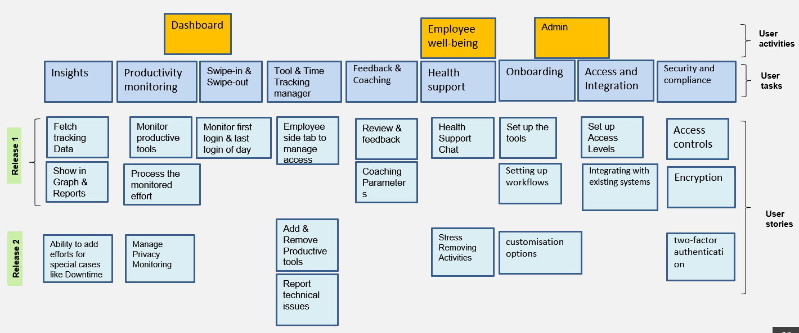
Assigment-1 Summary
Story Map
Product Discovery

Slide 8
MVP Features

Slide 9
MVP Features & it’s need
Automatic time tracking: The software should automatically monitor and record the active time of the employee on the office laptop/desktop. This feature is essential for the primary purpose of the product, which is to monitor employee productivity.
Productive software list: The employer/manager should be able to specify the list of productive software to monitor, and the software should only track the time spent on these applications. This feature is necessary to ensure that only work-related activities are monitored.
Swipe-in and swipe-out: The software should automatically record the total daily active hours of the employee and make an automatic entry in swipe-in and swipe-out for the day. This feature is necessary to enable the company to track employee attendance accurately and ensure that employees are being paid fairly.
Product Discovery

Slide 10
MVP Features & it’s need
Real-time usage summary: The employees should be able to view their active time summary in real-time to track their progress and ensure they are meeting their daily goals. This feature is essential to enable employees to manage their time better and increase their productivity.
Feedback and coaching: The software should allow managers to provide feedback and coaching to employees based on the data and analytics provided by the tool. This feature is essential to improve employee performance and productivity.
Mobile access: The software should allow employees to access the product from their mobile devices. This feature is necessary to enable employees to work from anywhere and at any time, increasing their flexibility and productivity.
User authentication and security : The software should allow employees to access the product from any device after the successful authentication with their official email address and login passwords.
Product Discovery

Slide 11
Hand Drawn Sketches

Slide 12
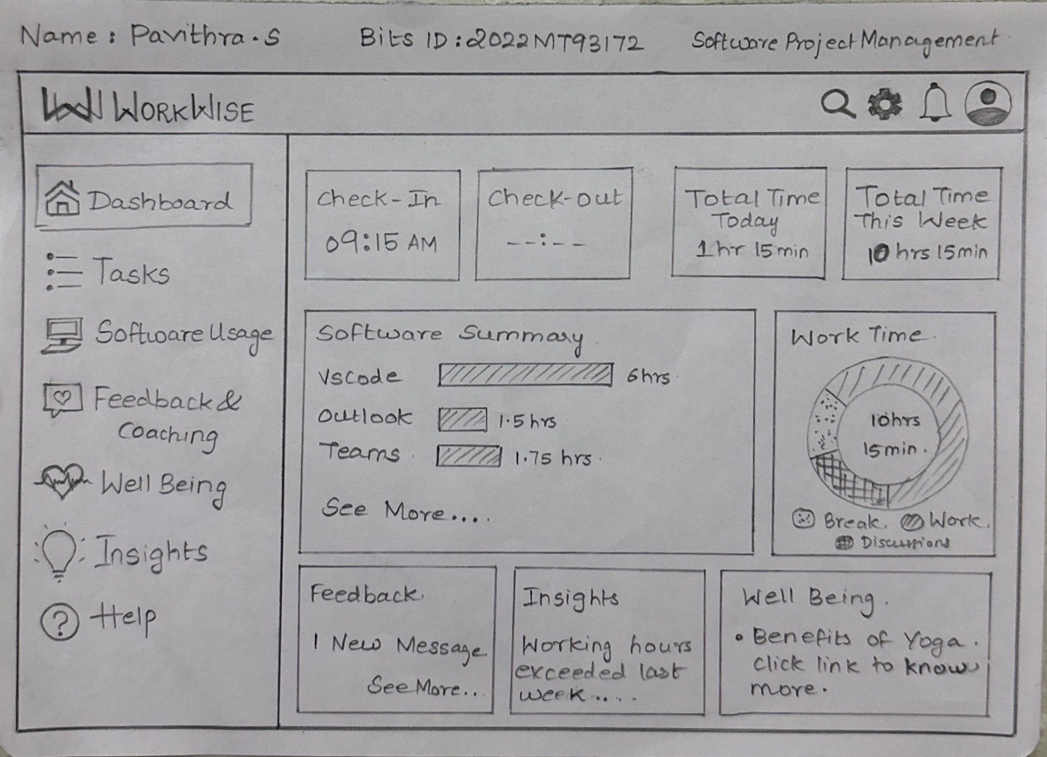
Hand Drawn Sketches by Team
Product Discovery

Slide 13
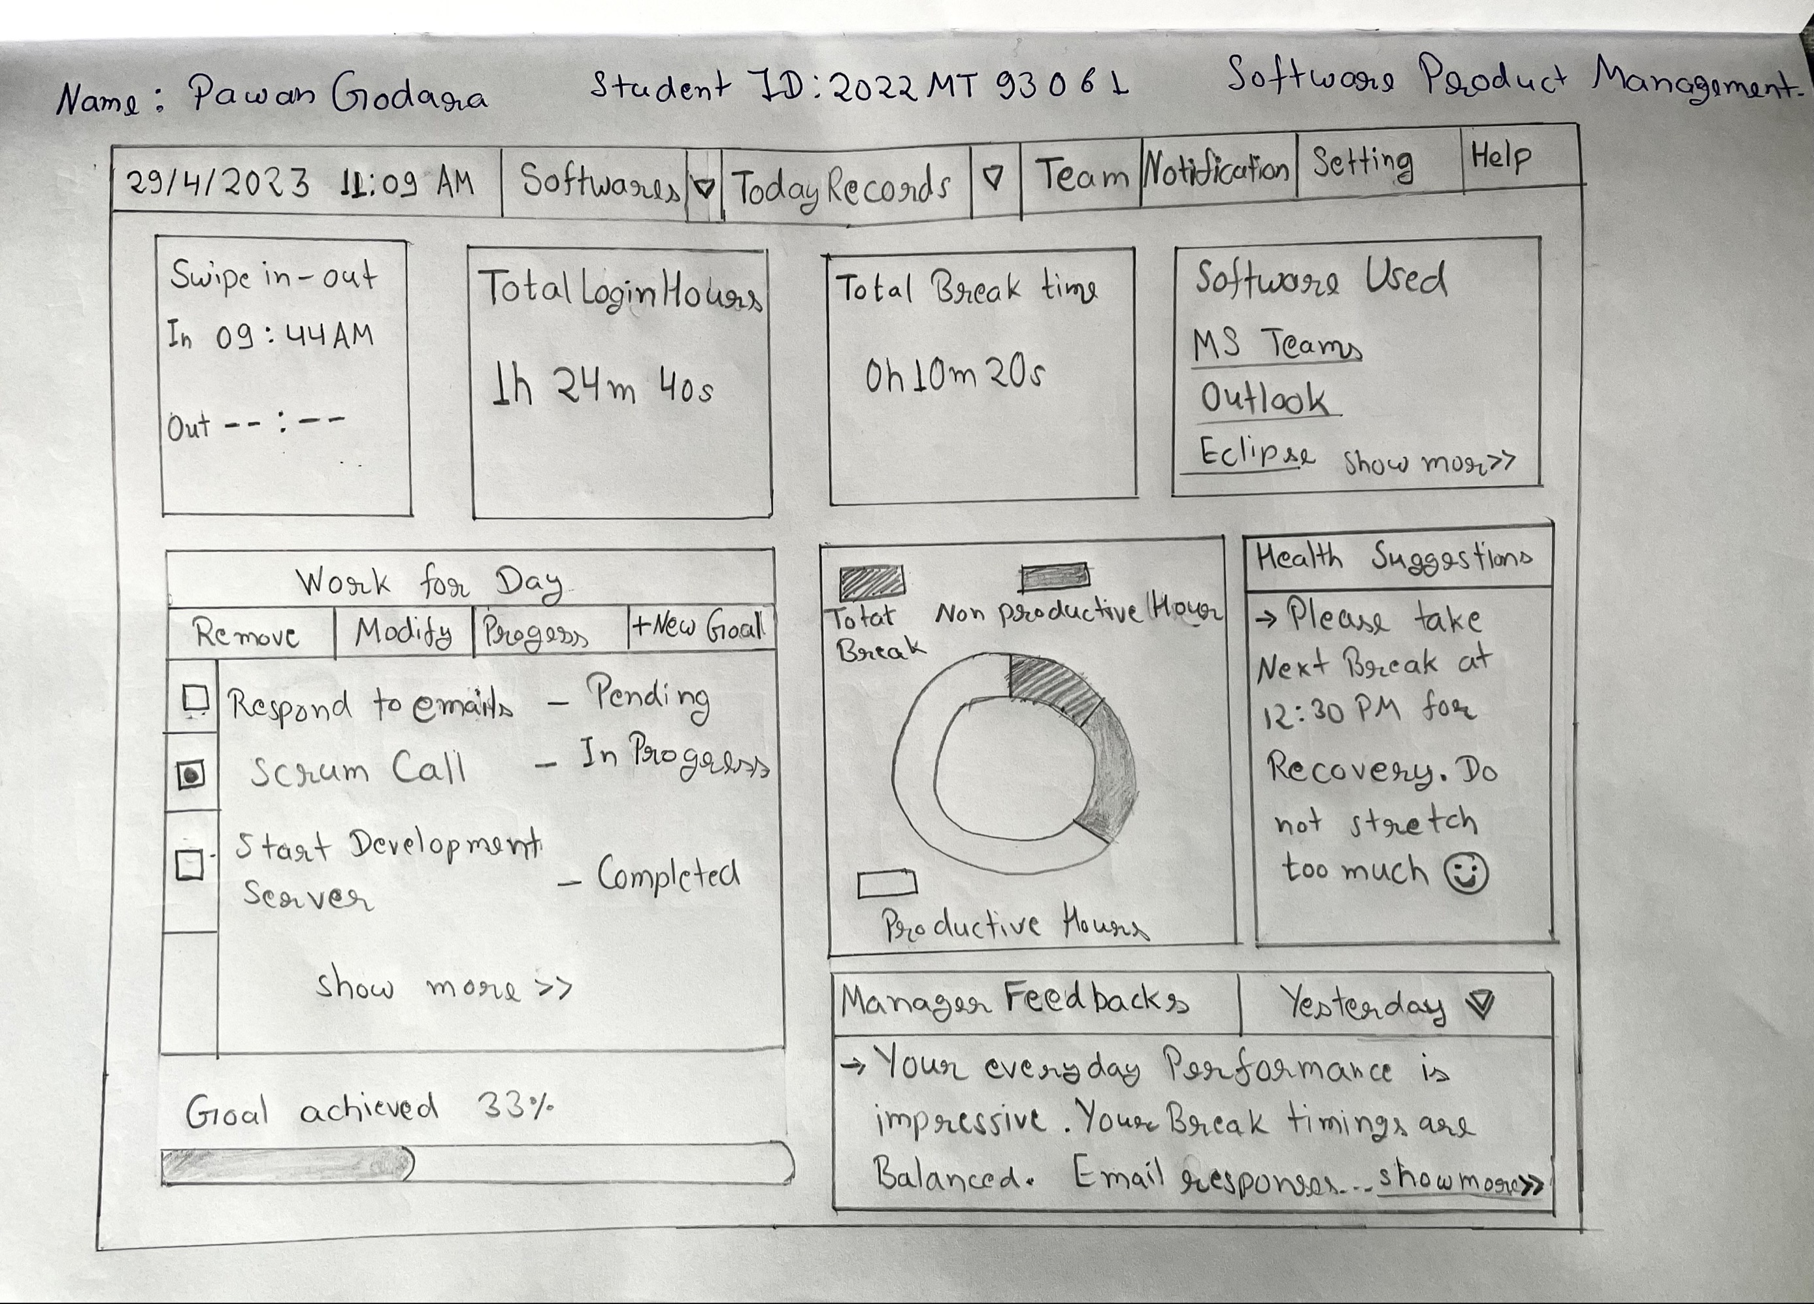
Hand Drawn Sketches by Team
Product Discovery

Slide 14
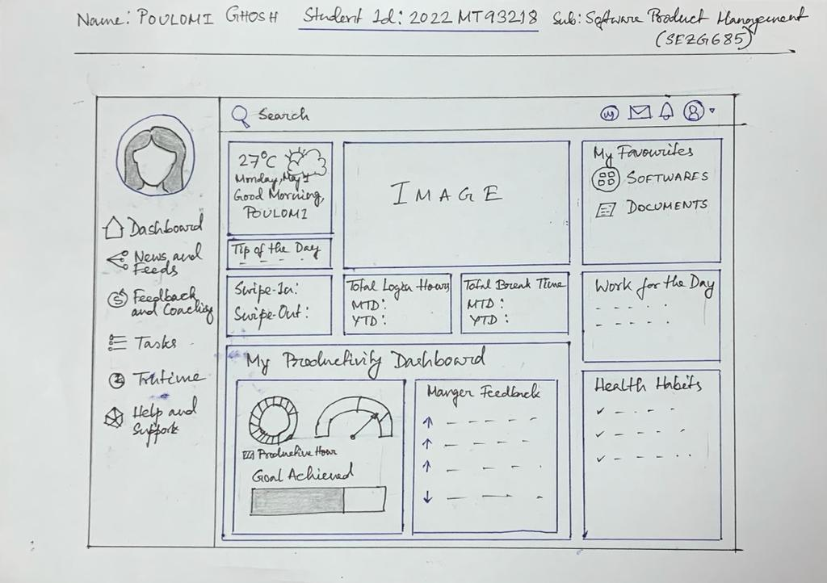
Hand Drawn Sketches by Team
Product Discovery

Slide 15
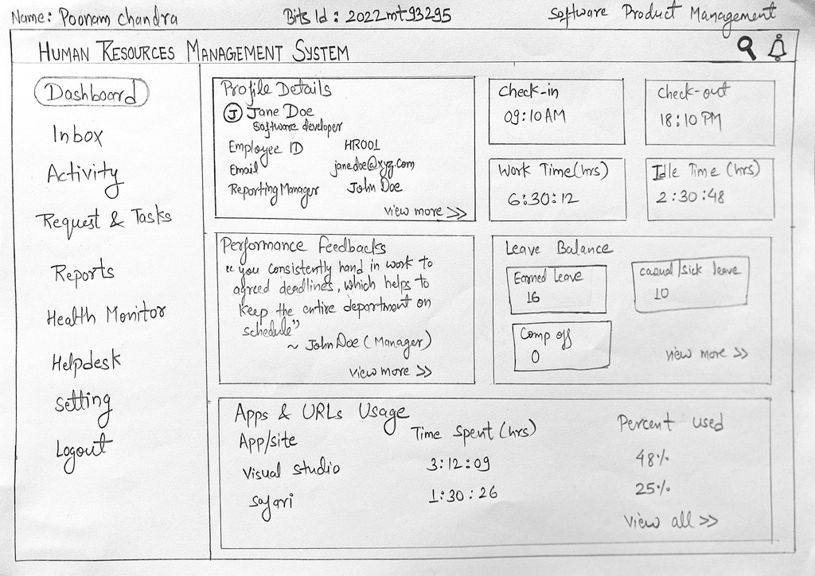
Hand Drawn Sketches by Team
Product Discovery

Slide 16
Finalized Sketch by Team
After evaluating the top three standout ideas from all the product sketches, our team voted and chose the following sketch for wireframe design.
Product Discovery

Slide 17
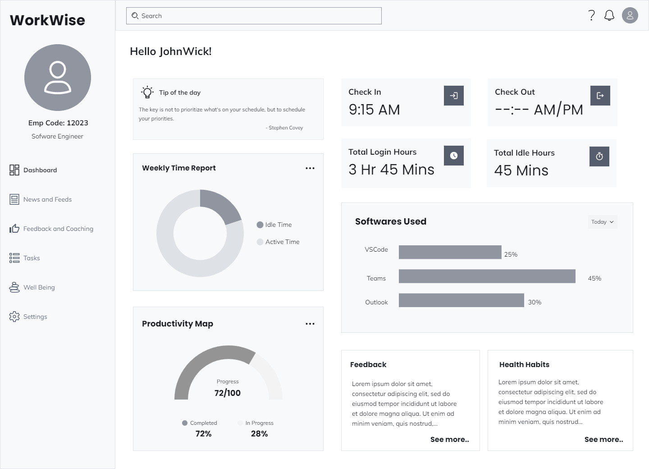
Wireframe Story Board
Based on the selected sketch, we have created a wireframe that includes all the features listed in the finalized sketch.
We have also enhanced the wireframe by including a chart to display the employee's software usage and a weekly time report chart, both of which were standout ideas from other sketches.
These additions provide a more comprehensive overview of the employee's productivity and work habits.

Slide 18
Customer Feedback
Customer 1:
I really like the user interface and design of the app. It's very clean and looks easy use. The app includes the usage time of various applications and tracks the time. But, there will be situations where the events are conducted offline. But that also is work time. How will the application handle this? Will that time be considered as work time or idle time?
Customer 2:
The app concept overall looks good. The addition of mental health resources and support is a great touch. It shows that the company cares about their employees' well-being. I noticed that the software's used section only shows the desktop applications. But, there will be tasks that involve research. Will the research in the web browsers also be tracked?

Slide 19
Customer Feedback
Customer 3:
The wireframe looks clean. The features provided will also help in understanding the work done in a day and where time is lost. Will this app also work on client laptop which may have additional security steps?
Customer 4:
The real-time usage summary is a very valuable feature for understanding how an employee utilizes their time. It's also helpful in detecting usage patterns, and the inclusion of such a feature will make this app extremely useful for management. The possibility of having offline functionality will provide an added advantage for employees working in areas with limited internet access.
Customer 5:
The app looks good. The app's features will certainly help managers keep track of employee productivity and performance. The comprehensive dashboard and charts will also make it easier to monitor and understand employee behavior. Overall, it looks like the app has great potential to be a valuable asset to any organization.

Slide 20
Customer Questions and Solution
Based on the wireframe presentation, we received feedback from our potential customers on specific aspects of the app. Here are the questions raised and the proposed solutions:
How can we handle the offline meetings and events timing in the app? Will it be shown as idle time or work time? -> We are adding a "Raise request" feature for offline events. This feature will allow employees to request approval for offline events, which will then be shown as "work time" in the app.
How are we tracking the research activities. The users will use search engines or offline support too. How are we handling that? -> We are updating the software summary section to include Apps/Urls summary. This will include the search engine activities and any offline support tools that the employees use.
How will the app work when using a client laptop? Is it based on the employee profile or the app needs to be installed? -> The app is currently focusing on the standalone app that needs to be installed on the client laptop. In the future, we may introduce a web app option as well.
Is it an online or offline tool? Web app or standalone app? -> WorkWise is a standalone app that collects data from both offline and online tools.

Slide 21
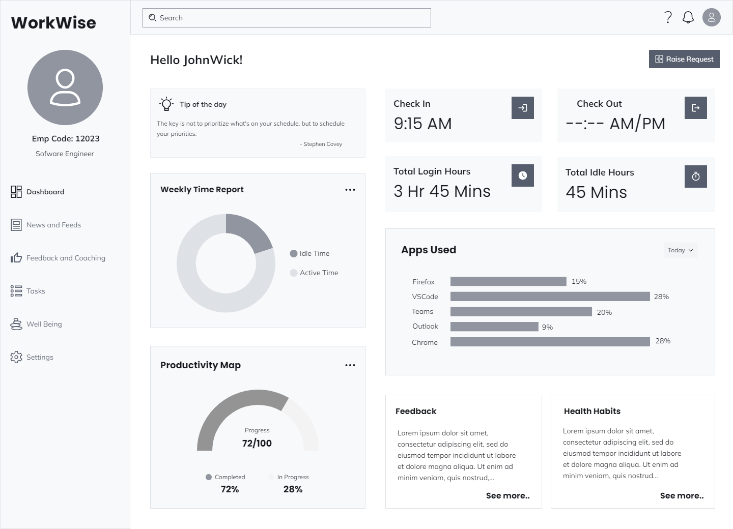
Updated Wireframe Story Board

Slide 22

Key Learnings - Pavithra.S (2022MT93172)
Starting with a product sketch: Hand-sketching product ideas can be a useful starting point to get ideas on paper and sharing them with the team.
Converting the sketch into a wireframe: Once the product sketch is ready, it's important to convert it into a digital wireframe to add more detail and create a clearer picture of what the product will look like.
Identifying MVP features: Finding out the most important features required for the product is important and those features need to be prioritized.
Importance of customer feedback: Seeking feedback from customers is crucial for creating a successful product. By listening to their suggestions and concerns, we can improve the product and make it more user-friendly.
Presentation Title

Slide 23
Key Learnings – Pawan (2022MT93061)
Collaboration: Working in a team to develop solutions for a problem can provide different perspectives and ideas, leading to better outcomes.
Creativity: Low-fidelity hand-drawn sketches can be a valuable tool for brainstorming and generating ideas quickly and effectively.
Prioritization: Identifying and prioritizing the most important features of a product based on the needs of the users and the goals of the project is essential for developing an effective MVP.
User-Centered Design: Developing a product that prioritizes the needs and experiences of the users is key to ensuring its success.
Agile Development: Focusing on developing a minimum viable product (MVP) that can be iterated upon and improved over time is a valuable approach for developing software products.
Presentation Title

Slide 24
Key Learnings – Poonam (2022MT93295)
Communication: Good communication is crucial for project success. This includes actively listening, asking questions, providing feedback, and keeping team members informed about progress and any changes.
Flexibility: In order to effectively tackle challenges, it is crucial to remain flexible, adaptive, and find innovative solutions by pivoting when necessary.
Teamwork and Collaboration: Successful team projects require teamwork and collaboration to ensure all members are working towards a shared goal, leveraging their skills and expertise to achieve success.
Attention to Detail: Paying close attention to detail is important to ensure that the project is completed accurately and to a high standard. This includes checking work for errors and making corrections as necessary.
Presentation Title

Slide 25
Key Learnings - Poulomi Ghosh (2022MT93218)
Collaboration & Teamwork:
Working within a diverse team help generate lateral perspective around the product proposition and come up with a compelling MVP for the envisioned product.
Detailed workshop and brainstorming helped gain the right alignment.
Innovation:
An important aspect in the product envision phase. Keeping right focus helped us bring in differentiated offering and values in the product.
Market Research:
Competitive landscape as well as market demand analysis helped us define the right set of priorities and thus scope the MVP appropriately.
In real-life product budget and milestone will depend on these criteria significantly.
Thank you for the opportunity to work on the Group Assignment.
Presentation Title

Slide 26


Thank you
Pavithra.S - Group 39
2022mt93172@wilp.bits-pilani.ac.in
Product Discovery

